Slide 1
\
Request for Proposals # 2
TCU Building Bridges Grant Program
A Science, Technology, Engineering & Math (STEM) grant-funding opportunity developed in partnership with the American Indian Higher Education Consortium (AIHEC) and the National Aeronautics and Space Administration (NASA)
Information Session & Call for proposals

Slide 2
Today’s Agenda
Welcome
Team Introductions
RFP Overview
Priority Areas for Support
Programmatic Goals & STEM Engagement Goals
Web Navigation & Discussion
Closing & Next Steps

Slide 3
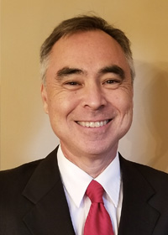
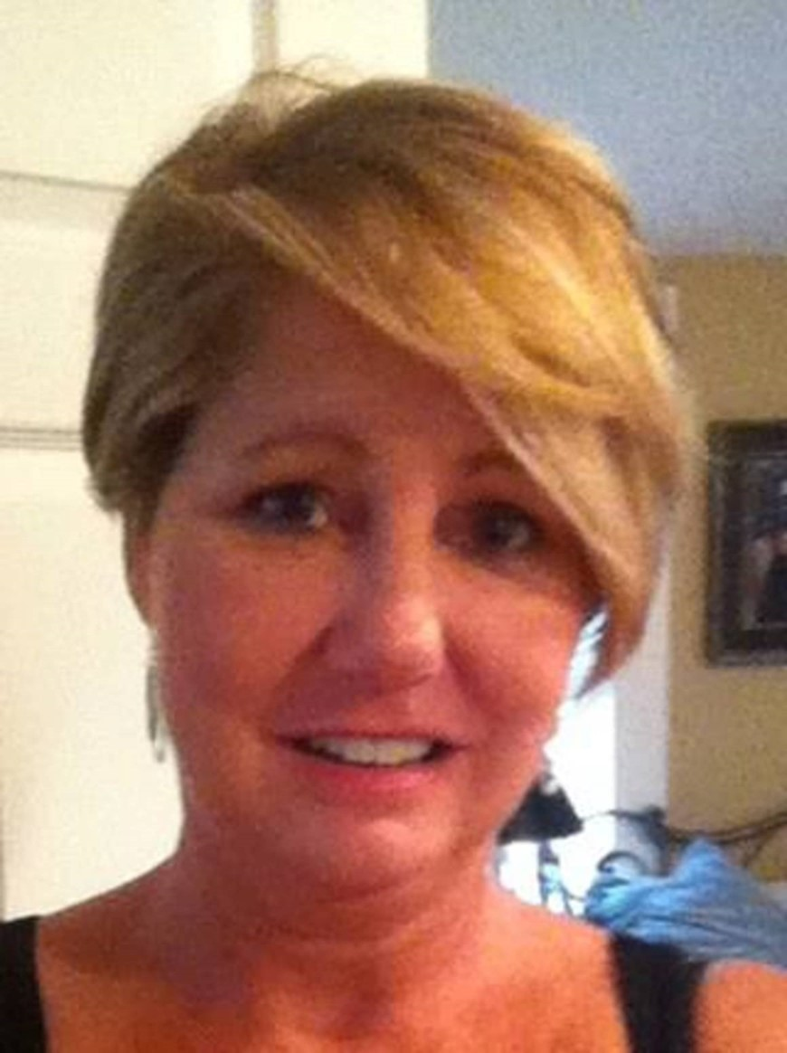
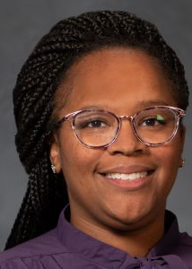
AIHEC & NASA Team

Slide 4
RFP Overview – Purpose
The Building Bridges Grant program is designed to provide funds to improve infrastructure, update academic program content, student research opportunities, faculty professional development, bridging activities, and other initiatives to support TCU efforts to develop and enhance their STEM programs.
Through the provision of funding, it is NASA & AIHEC’s hope that the program will enhance the ability of TCUs to:
Provide high quality STEM education programs
Participate in collaborative STEM research initiatives
Ensure the inclusion of American Indians and Alaskan Natives in a well-prepared NASA STEM workforce.

Slide 5
RFP Overview
RFP RELEASE DATE: September 16, 2024
PROPOSAL DUE DATE: 11:59 PM Eastern Time (ET) November 12, 2024
FUNDING AMOUNT: Multiple awards of up to $68,600 are available ($686,000 total each year)
ELIGIBILITY: Funds are available to faculty led teams from all accredited Tribal Colleges & Universities
ESTIMATED CONTRACT PERIOD: January 16, 2025, through January 15, 2027, or up to 2 years (24 months) from date of award, depending on the scope of the project. Projects designed for shorter periods of time will receive equal consideration. If projects last 1 year or less, projects can be renewed for a second cycle with an additional award.

Slide 6
RFP Overview – Priority Areas
Priority areas for support will include, but are not necessarily limited to:
Research opportunities for undergraduate students;
STEM program instrumentation/equipment acquisitions;
Course and curriculum enhancements (new courses, delivery support technologies)
Professional development for TCU faculty, including conferences and workshops;
In-person meetings with NASA researchers and engineers available for collaborative projects;
Other activities that increase TCU students’ interest and engagement in STEM fields, at the elementary, high school and undergraduate level, including participation in STEM enrichment activities, conferences, workshops and competitions.
If awarded, grantees will also receive ongoing technical assistance from both AIHEC as well as NASA to support program success.
Notes:
We are trying our best to be expansive, not restrictive. Hopefully the message you take away from this is that there are a lot of possibilities, and if you are unsure, just ask!

Slide 7
RFP Overview - Programmatic Goals
The NASA AIHEC Bridges Program seeks STEM program enrichment projects such as course and curriculum development, research activities, and student engagement with the overall goal of broadening TCU students’ participation in STEM. NASA AIHEC Bridges Program funded projects are expected to address at least two of the three program goals:
Increase the number of Tribal College students engaging in STEM research and education activities. (Examples: internships, externships, Experiential Learning Opportunities (ELOs), Research Experiences for Undergraduates (REUs))
Increase the enrollment of Tribal College students in STEM degree programs and pursuing STEM career pathways
Strengthen the capacity of the Tribal College to deliver STEM courses, degrees and curriculum.
Notes:
We are trying our best to be expansive, not restrictive. Hopefully the message you take away from this is that there are a lot of possibilities, and if you are unsure, just ask!

Slide 8
RFP Overview - STEM & Engagement Goals
In addition to addressing the stated goals above, each proposal must demonstrate how they will align to at least one of the following NASA Office of STEM Engagement Goals below:
1. Strategic Goal 1.0: Create unique opportunities for a diverse set of students to contribute to NASA’s work in exploration and discovery.
2. Strategic Goal 2.0: Build a diverse future STEM workforce by engaging students in authentic learning experiences with NASA’s people, content and facilities.
3. Strategic Goal 3.0: Attract diverse groups of students to STEM through learning opportunities that spark interest and provide connections to NASA’s mission and work.
Notes:
We are trying our best to be expansive, not restrictive. Hopefully the message you take away from this is that there are a lot of possibilities, and if you are unsure, just ask!

Slide 9
AIHEC’s TCU Building Bridges Webpage
WEBPAGE LINK
WEBPAGE NAVIGATION:
Links to Webinar Registrations and Supporting Media
Post-webinar, links to PowerPoints and Webinar Recordings can be found here
Documents and Templates
Submission Buttons
Pre-Application Submission – Note: 10/16 deadline
NASA Building Bridges Resource Bank

Slide 10
Timeline
& Overview
To guide the application process, four webinars will be held to provide guidance, highlight best practices, offer resources, outline expectations, and address questions.
\
Each cycle, 5 webinars will take place to support the proposal development process.
1 – Information Session + Q & A (60 Min) (September 26)
2 – Workshop: Community of Practice (October 4)
3 – Workshop: Building A Competitive Proposal (October 11)
4 – Workshop: Budget Development (October 18)
5 – Office Hours (October TBD)
*Webinars will also be recorded and uploaded to AIHEC.org for review

Slide 11
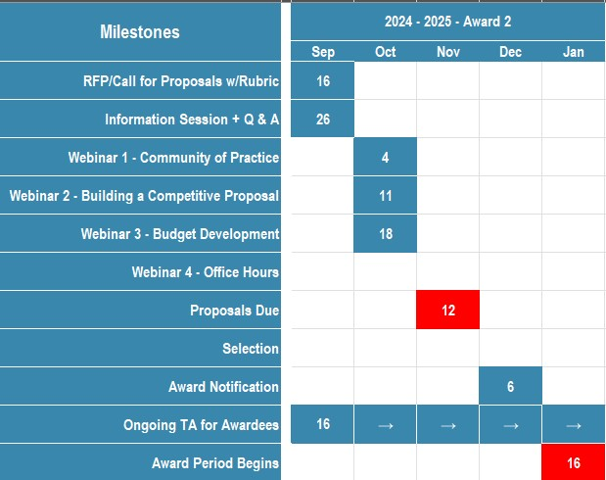
\
Timeline
& Overview
Notes:
Will be part of intro slides in future sessions

Slide 12
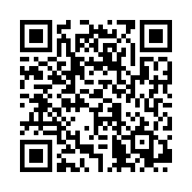
\
Thank you for coming!
Please complete our survey:
We will come back together next Friday, October 4th for a community of practice meeting
Notes:
https://app.smartsheet.com/b/form/d7b1cc948a424d849d977da80b65758e

